Slide 1
President and Vice President
CNH| K E Y C L U B
INSERT TOPICS
Presented by:
William Oh
Claudia Diaz
D16 Officer Training Conference

Slide 2
President
CNH| K E Y C L U B
Being a president of the club does not mean that you are of a higher position than any other officer. You should serve your club and guide them in the right direction.
D16 Officer Training Conference

Slide 3
CNH| K E Y C L U B
General Duties of a President
Appointing and Delegating
Attending
Evaluating
Goal Setting
Monitoring
Motivating
Presiding
Problem Solving
Recruiting and Retaining
Reporting
Succession
Training
D16 Officer Training Conference

Slide 4
CNH| K E Y C L U B
Communication is the KEY
Set up an emailing group for both the board and members
Google Groups & Reflectors
Inform members about upcoming events
Communicate with your Lt. Governor
Talk to faculty and Kiwanis advisors
D16 Officer Training Conference

Slide 5
CNH| K E Y C L U B
Action
Serve as the chief executive officer
Call and preside over board meetings
Delegate and assign tasks
Ensure all assigned tasks are completed
Hold elections prior to DCON and submit a new board roster to your Lt. Governor
D16 Officer Training Conference

Slide 6
CNH| K E Y C L U B
Attend
Represent the club at Kiwanis meetings
Represent the club at Division Council Meetings (DCMs)
Attend service projects and club/division events
D16 Officer Training Conference

Slide 7
CNH| K E Y C L U B
Delegating
Be able to delegate tasks to peers
Provide the opportunities for others to lead. Give them leadership opportunities that will inspire them to become leaders as well!
Do not do everything by yourself!
Learn to say “No”.
Although you might prefer to do things yourself, take some weight off your shoulders and allow others to help you.
D16 Officer Training Conference

Slide 8
CNH| K E Y C L U B
Service: Lead by Example
GIVE BACK
Set an example to the members you serve on how to give back!
Keep members involved!
Weekly to bi-monthly service events
Show them the merit in giving back!
Smile while serving
Connect with the people you are helping
Enjoy service and show just how big of an impact the members are making!
D16 Officer Training Conference

Slide 9
CNH| K E Y C L U B
Setting REALISTIC Goals
Service Hours: Our club will achieve ___ service hours per member.
Membership: Our club will retain our current membership and raise it by ___ members.
Fundraising: Our club will contribute $___ to Pediatric Trauma Program and $___ to the Eliminate Project.
Include your board. Have them contribute to the goal discussion.
D16 Officer Training Conference

Slide 10
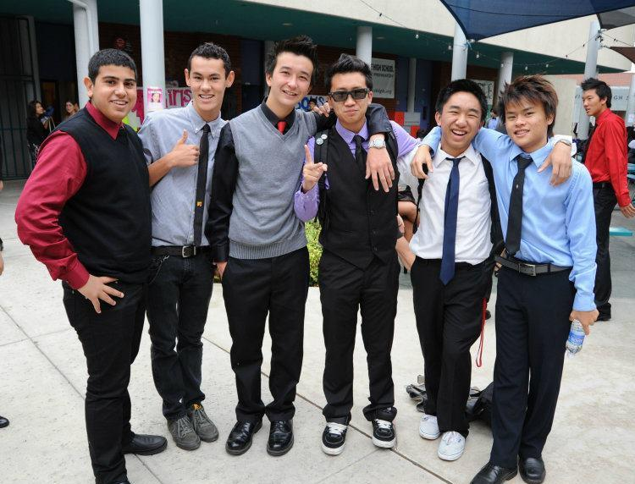
CNH| K E Y C L U B
The Board YOU Serve
Vice President: Your sidekick, best friend forever, the jelly to your peanut butter.
Secretary: Your aid, your minute-man.
Treasurer: Your money-man, fundraising-brainstormer.
Editor: Your tech-man, publicist.
Class Representatives: Your advertisers.
D16 Officer Training Conference

Slide 11
CNH| K E Y C L U B
The Members YOU Serve
Be available
Know the members in the club
Be thankful
Ask for ideas
Take surveys
Keep them in the loop
You exist to serve the members!
Be an advisor to them!
Support them, and give them the chances to grow and develop themselves as individuals and leaders!
They’re your OHANA
D16 Officer Training Conference

Slide 12
CNH| K E Y C L U B
The Importance of Deadlines
Every officer should have received a Key Club Planner. Utilize the planner to plan events and to meet deadlines.
If you don’t have a Key Club planner, invest in buying one at your local office supplies store, it’s worth it!
PROCRASTINATION IS YOUR WORST ENEMY
When you meet your deadlines, everyone is happy. If you don’t, be warned that there are consequences.
D16 Officer Training Conference

Slide 13
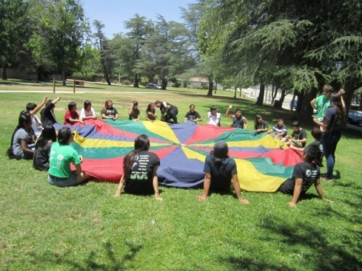
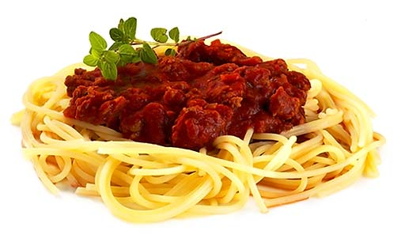
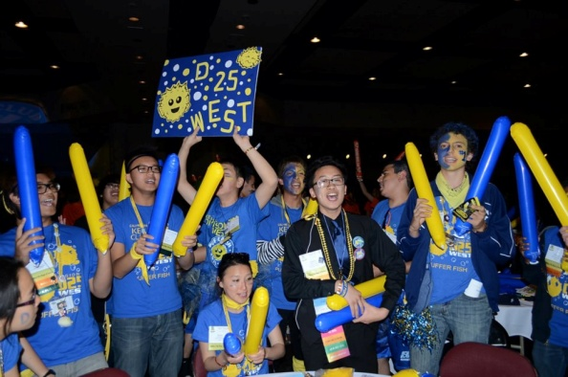
CNH| K E Y C L U B
No one showing up? No problem.
Meetings
Food
Icebreakers
Music
Events
District Convention
Big Events
Long term events
D16 Officer Training Conference

Slide 14
CNH| K E Y C L U B
Vice President(s)
Assist all officers within your club to achieve success. Overlook and/or lead committees. Help find service events and keep in touch with the faculty and Kiwanis advisor.
D16 Officer Training Conference

Slide 15
CNH| K E Y C L U B
Who are YOU?
EXECUTOR (no, not that kind)
Make sure things get done
“bad guy” (but not really)
Hold members accountable
GLUE
Connects the members to the officers
UNDERSTUDY
Prepared to step up at any time
Flexible schedule and is always prepared
D16 Officer Training Conference

Slide 16
CNH| K E Y C L U B
Assist and Ask
Monitor all other officer work to ensure that it is completed on time and help when needed
Have exceptional knowledge of Key Club on the District and International level
Educate the new members
Ask for additional tasks
Help transition the new vice president
D16 Officer Training Conference

Slide 17
CNH| K E Y C L U B
Weekly – Create Agendas
WHY:
Ensure board members are on the same page
Ensure delegation of tasks
HOW:
Propose agenda items during board meetings
Obtain secretary minutes
D16 Officer Training Conference

Slide 18
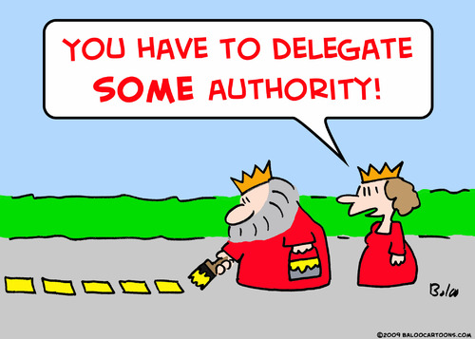
CNH| K E Y C L U B
Monthly – Committee Delegation
WHY:
Get members involved
Don’t overwhelm yourself
HOW:
Offer assistance, guidance
DELEGATE tasks
D16 Officer Training Conference

Slide 19
CNH| K E Y C L U B
Monthly – Visit Your Kiwanis Clubs!
WHY:
Ensure a strong bond with your Kiwanians
Get service opportunities
HOW:
Attend meetings
E-mail/Call
D16 Officer Training Conference

Slide 20
CNH| K E Y C L U B
Annually – Locate Service Opportunities
WHY:
EVERYONE should be looking
Create a diversity of events
HOW:
Check with your LtG, Kiwanis Clubs, CNH Cyberkey, online, etc!
ASK your MEMBERS!
D16 Officer Training Conference

Slide 21
CNH| K E Y C L U B
Annually – Recruit
WHY:
Increase membership
Expand your club
HOW:
Work with the Public Relations Officer
Brainstorm with other members and officers
D16 Officer Training Conference

Slide 22
CNH| K E Y C L U B
General Tips
Ask for tasks to help the president
Work with officers and members to develop new project ideas
Brainstorm ideas with others
Monitor what you are posting online
Dress and act professionally
Need ideas? Look at distinguished vice president guidelines! (Updated again in September 2013)
D16 Officer Training Conference

Slide 23
CNH| K E Y C L U B
Resources
Presidents & Vice President’s Manual
CNH CyberKey (cnhkeyclub.org)
Key Club International (keyclub.org)
President’s & Vice President’s Google Reflectors
LTG Claudia Diaz (d16.ltg.cnhkc@gmail.com ; 818 471-6007)
Your Kiwanis Advisor or Faculty Advisor
D16 Officer Training Conference

Slide 24
CNH| K E Y C L U B
Questions?
D16 Officer Training Conference

